Slide 1
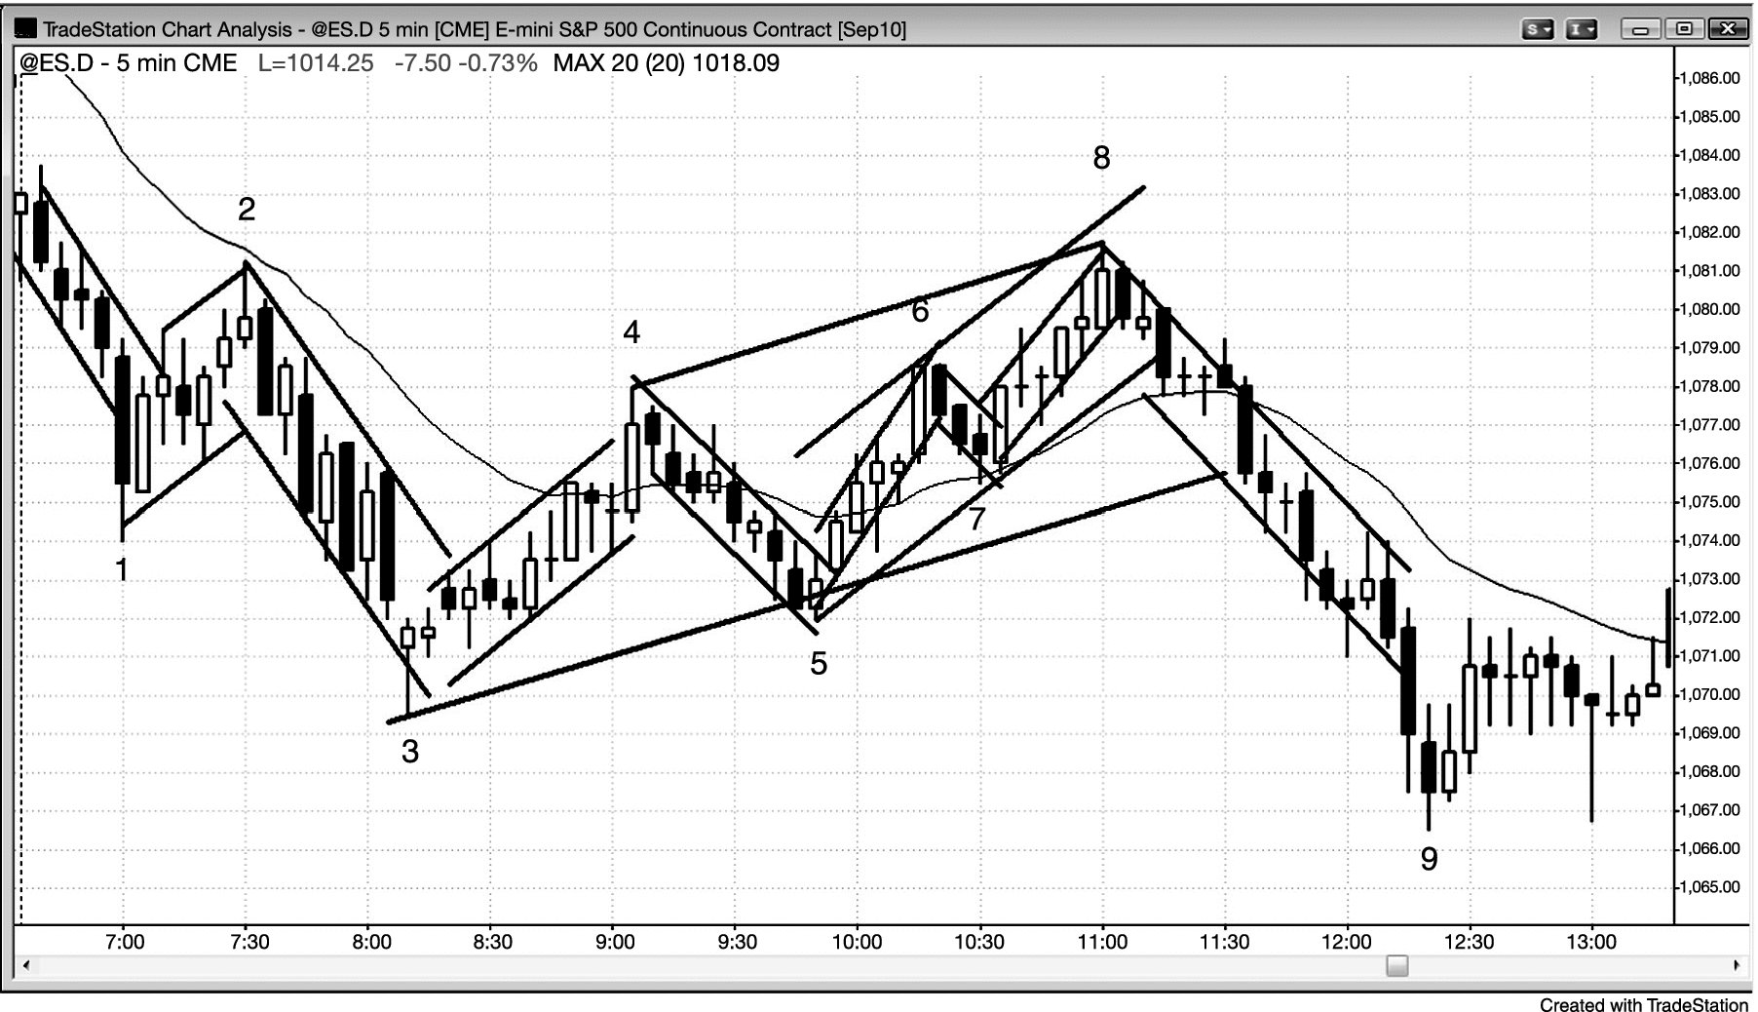
FIGURE 15.1 Nested Channels

Slide 2
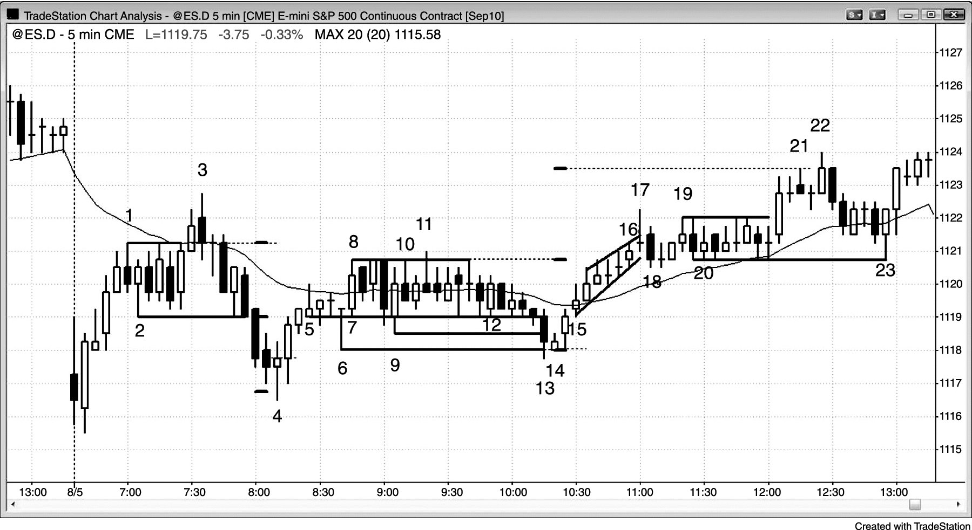
FIGURE 15.2 Failed Channel Breakouts

Slide 3
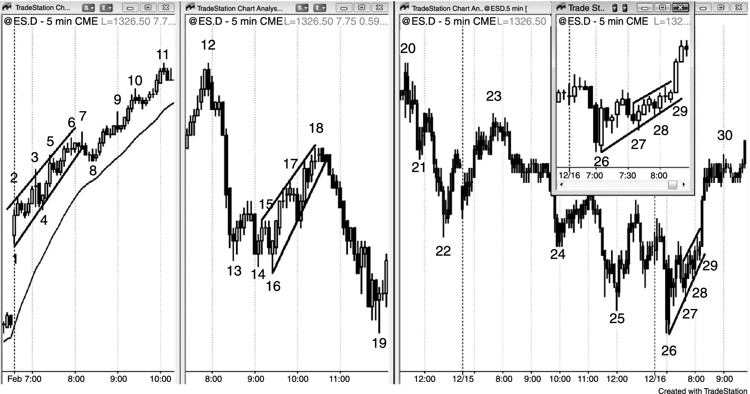
FIGURE 15.3 Bull Channels in Bull and Bear Markets

Slide 4
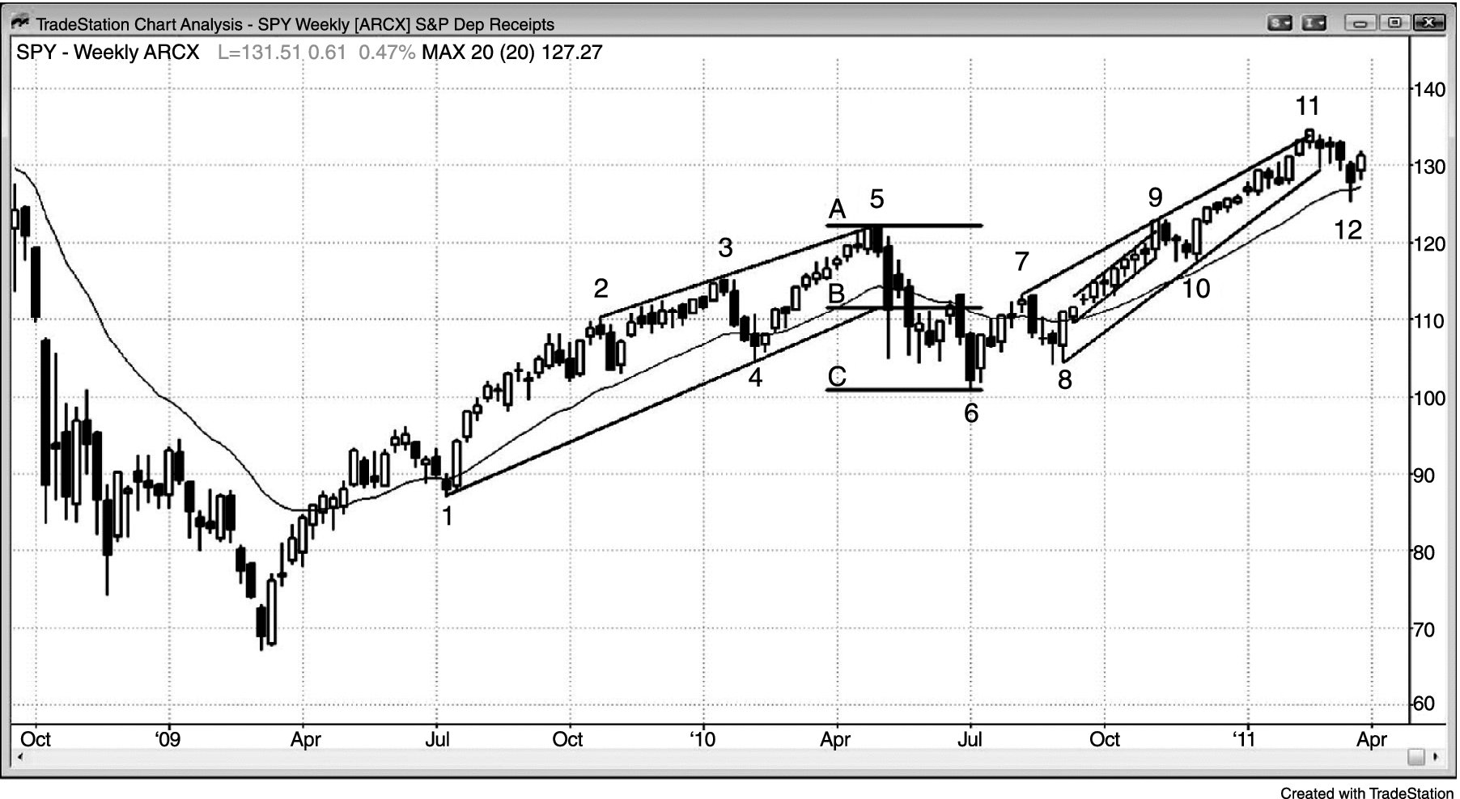
FIGURE 15.4 Channel Breakout and Measured Move

Slide 5
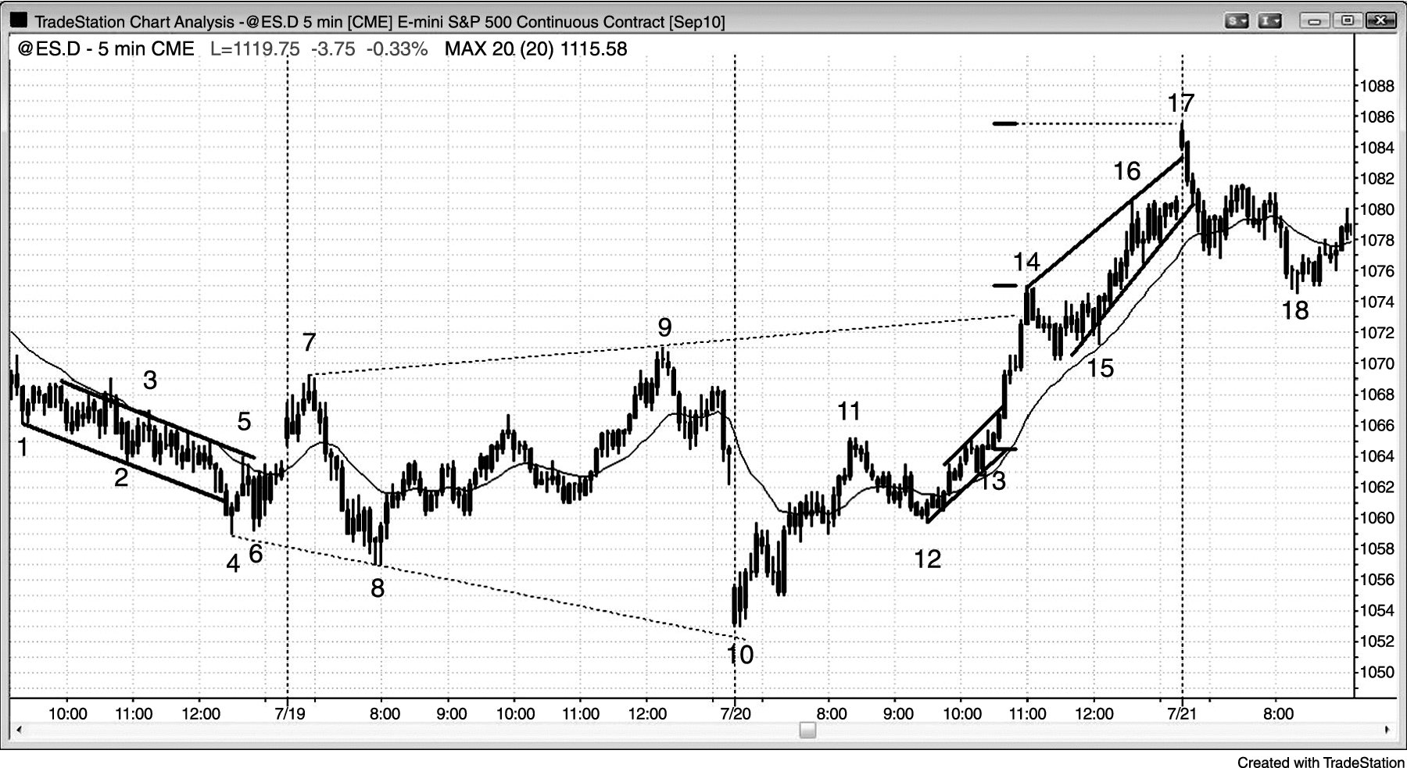
FIGURE 15.5 Climactic Bear Breakout of Bear Channel

Slide 6
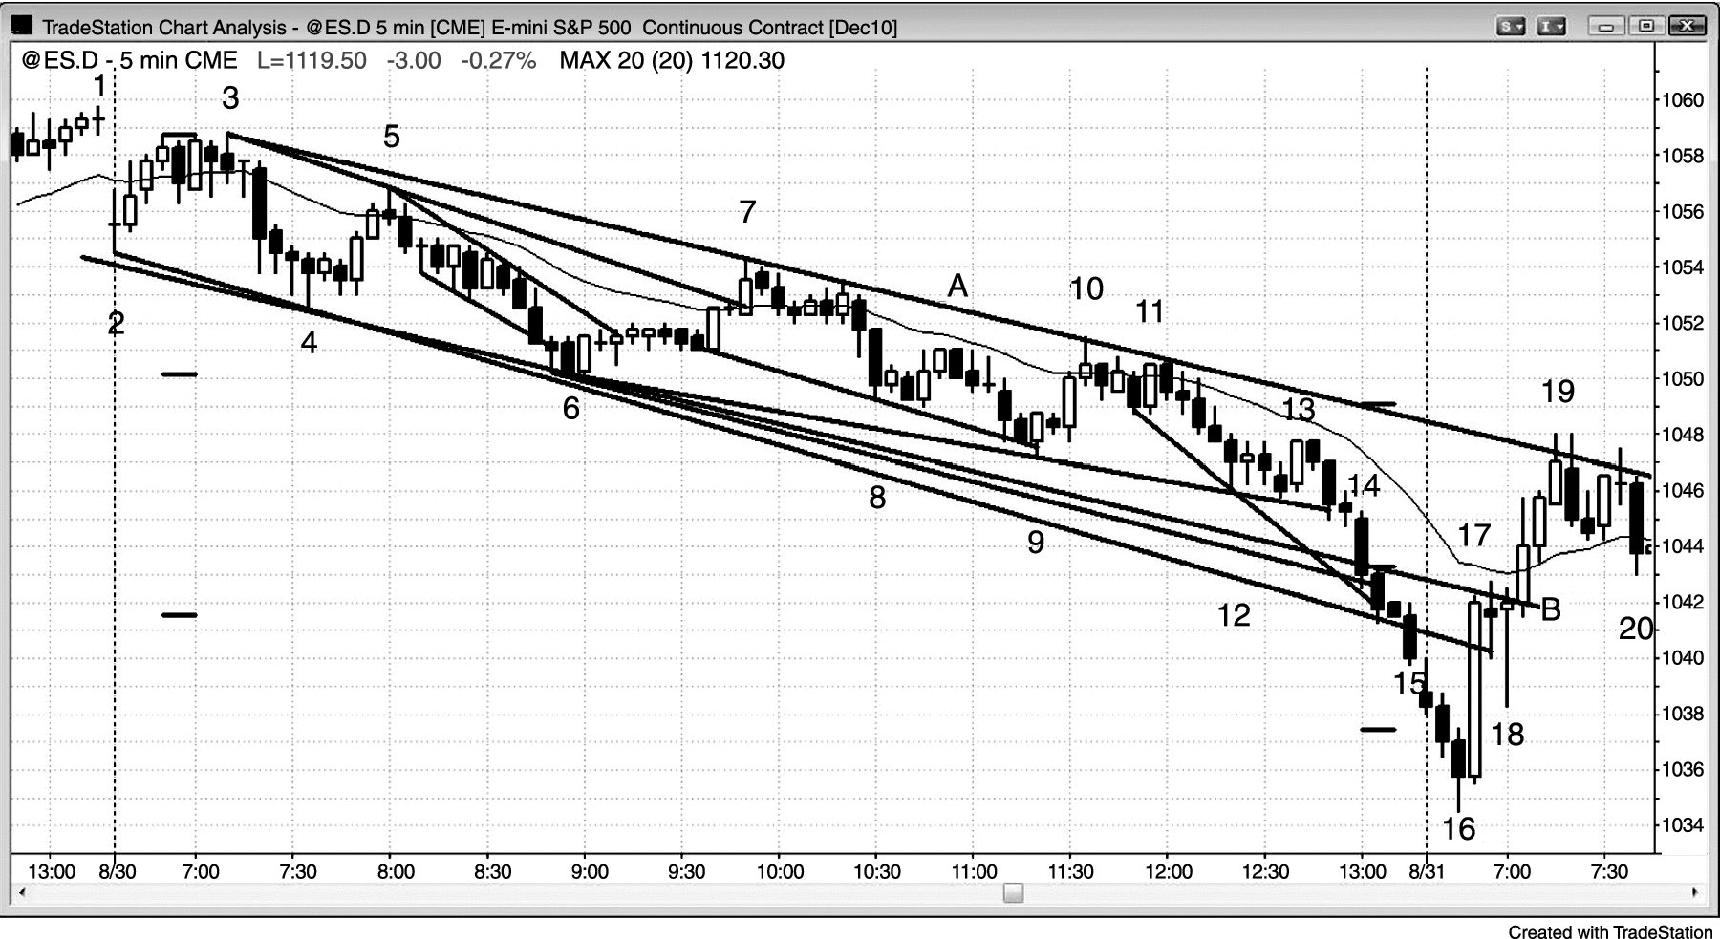
FIGURE 15.6 Reversals at Lines

Slide 7
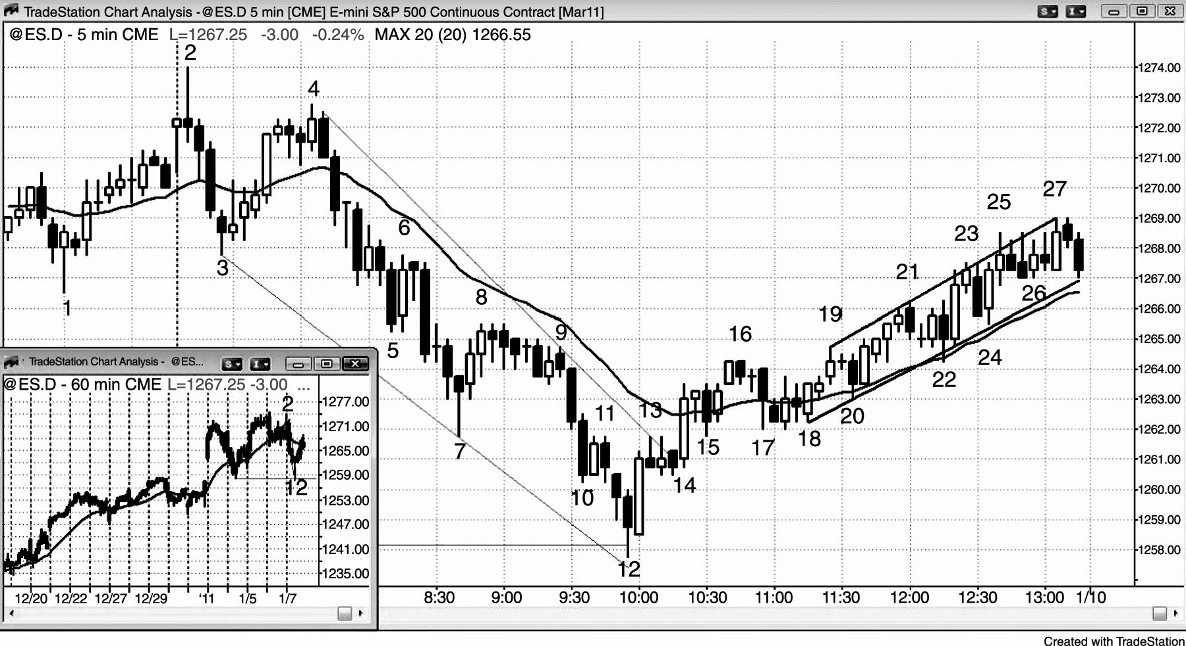
FIGURE 15.7 Channels Are Always Trying to Reverse

Slide 8
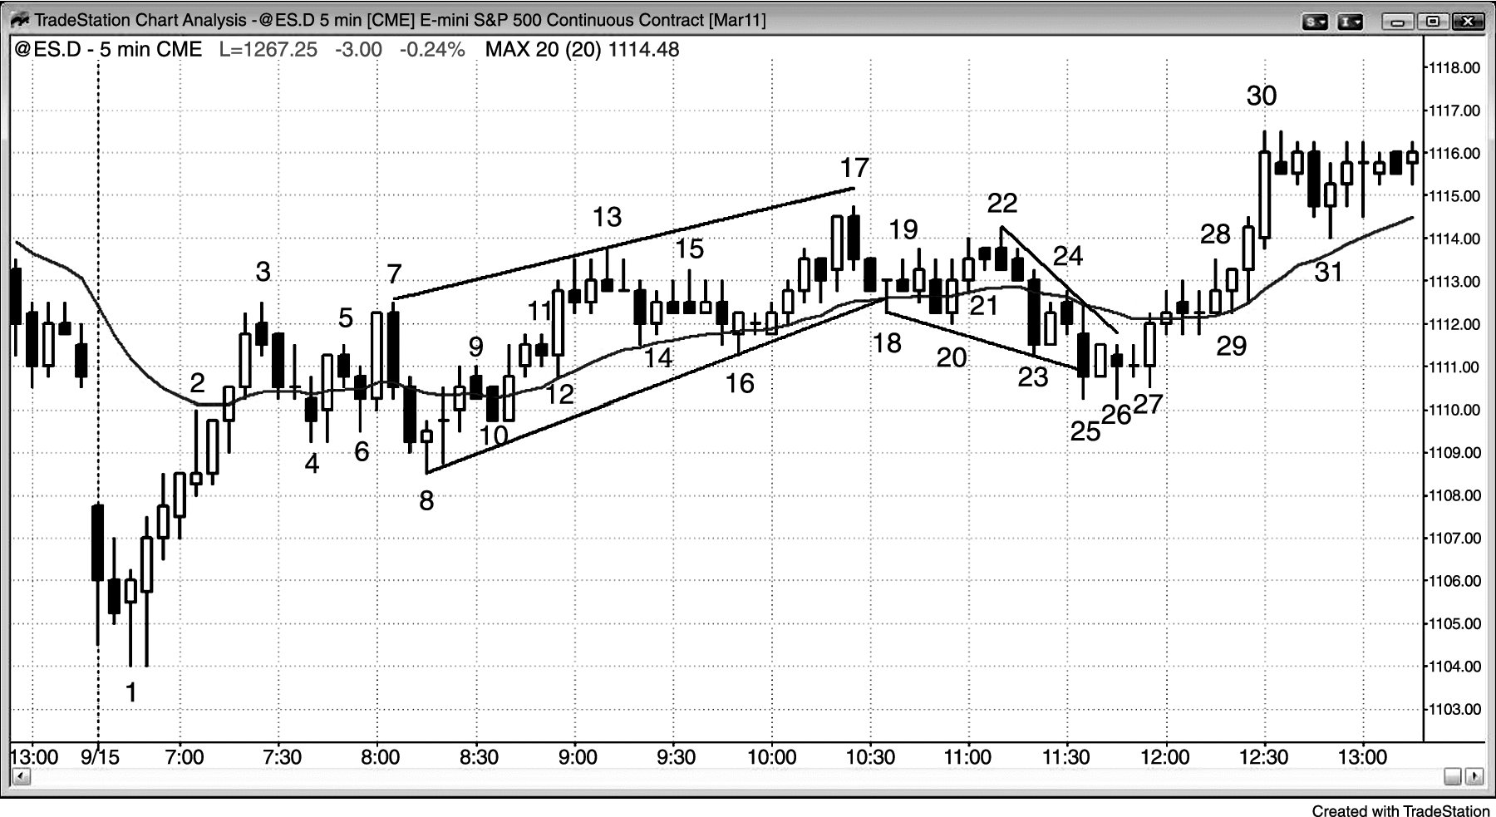
FIGURE 15.8 Entering on Limit Orders in Channels

